Slide 1
Embrace Diversity Newsletter
Here is where your presentation begins

Slide 2
Content of This Template
Here’s what you’ll find in this Slidesgo template:
A slide structure based on a newsletter, which you can easily adapt to your needs. For more info on how to edit the template, please visit Slidesgo School or read our FAQs.
An assortment of illustrations that are suitable for use in the presentation can be found in the alternative resources slide.
A thanks slide, which you must keep so that proper credits for our design are given.
A resources slide, where you’ll find links to all the elements used in the template.
Instructions for use.
Final slides with:
  The fonts and colors used in the template.
  A selection of illustrations. You can also customize and animate them as you wish with the online editor. Visit Stories by Freepik to find more.
  More infographic resources, whose size and color can be edited.
  Sets of customizable icons of the following themes: general, business, avatar, creative process, education, help & support, medical, nature, performing arts, SEO & marketing, and teamwork.
You can delete this slide when you’re done editing the presentation.

Slide 3
01
04
02
05
03
Announcements
Welcome!
Here you could describe the topic of the section
Here you could describe the topic of the section
In Depth
Events
Here you could describe the topic of the section
Here you could describe the topic of the section
Here you could describe the topic of the section
In Brief
Here you could describe the topic of the section

Slide 4
01
Announcements

Slide 5
The Slide Title Goes Here!
Do you know what helps you make your point clear? Lists like this one:
● They’re simple
● You can organize your ideas clearly
● You’ll never forget to buy milk!
And the most important thing: the audience won’t miss the point of your presentation

Slide 6
1st
Announcement
Mercury is the closest planet to the Sun and the smallest one in the Solar System—it’s only a bit larger than the Moon. The planet’s name has nothing to do with the liquid metal, since it was named after the Roman messenger god, Mercury

Slide 7
2nd
Announcement
Jupiter
Venus
Mercury
Planet Jupiter is the biggest object in the Solar System and also a huge gas giant
It has a beautiful name and is the second planet from the Sun in the Solar System
Planet Mercury is the closest object to the Sun in the Solar System and the smallest one

Slide 8
02
In Depth

Slide 9
Awesome Words

Slide 10
In Depth
Mercury
Mercury is the closest planet to the Sun and the smallest one
Mars
Despite being red, planet Mars is actually a cold place
Jupiter
Jupiter is the biggest planet in the Solar System
Neptune
Saturn
Neptune is the fourth-largest planet in the Solar System

Slide 11
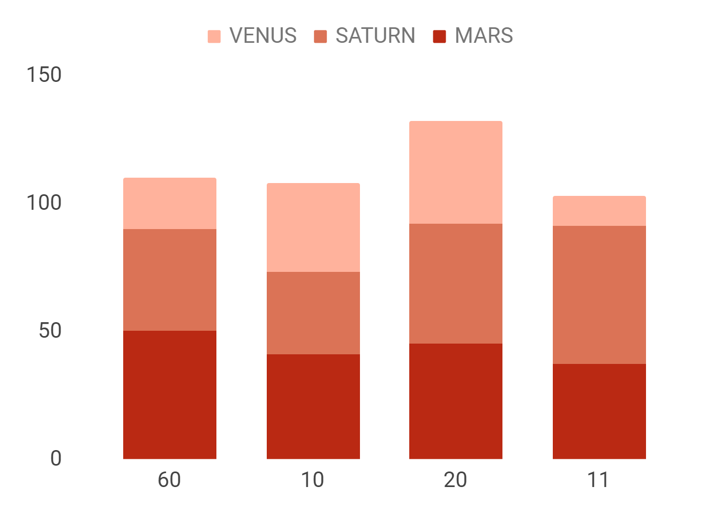
In Depth
Saturn
Venus
Mars
Mercury is the closest planet to the Sun and the smallest one in the Solar System
To modify this graph, click on it, follow the link, change the data and paste the resulting graph here

Slide 12
4,498,300,000
Big numbers catch your audience’s attention

Slide 13
333,000.00
386,000 km
24h 37m 23s
Earths is the Sun’s mass
Between Earth and the Moon
Is Jupiter’s rotation period

Slide 14
Sector News
Mars
Jupiter
Despite being red, Mars is a cold place full of iron oxide dust
Jupiter is the biggest planet in the entire Solar System

Slide 15
03
In Brief

Slide 16
News
It has a beautiful name and is the second planet from the Sun
It’s the biggest object in the Solar System and also a gas giant
Mercury is the smallest planet in the entire Solar System
Despite being red, planet Mars is actually a very cold place
Neptune is the fourth-largest planet in the Solar System
It’s the ringed one. It’s mostly made of hydrogen and helium

Slide 17
Customer Reviews
Laura Patterson
Jenna Smith
“It’s the biggest object in the Solar System and also a gas giant”
“Neptune is the farthest planet from the Sun“
John James
Richard Roe
“Mercury is the smallest planet in the Solar System”
“It’s the ringed one. It’s mostly made of hydrogen and helium”

Slide 18
Map
Mercury
Mercury is the closest planet to the Sun and the smallest one in the Solar System—it’s only a bit larger than the Moon

Slide 19
04
Welcome!

Slide 20
Welcome!
Sarah Doe
Mercury is the closest planet to the Sun and the smallest one in the Solar System—it’s only a bit larger than the Moon

Slide 21
Welcome!
John Doe
Mercury is the closest planet to the Sun and the smallest one in the Solar System—it’s only a bit larger than the Moon

Slide 22
Timing
SEPTEMBER
Mon | Tue | Wed | Thu | Fri | Sat | Sun
01 | 02 | 03 | 04 | 05 | 06 | 07
08 | 09 | 10 | 11 | 12 | 13 | 14
15 | 16 | 17 | 18 | 19 | 20 | 21
22 | 23 | 24 | 25 | 26 | 27 | 28
29 | 30
Neptune
Saturn
Jupiter

Slide 23
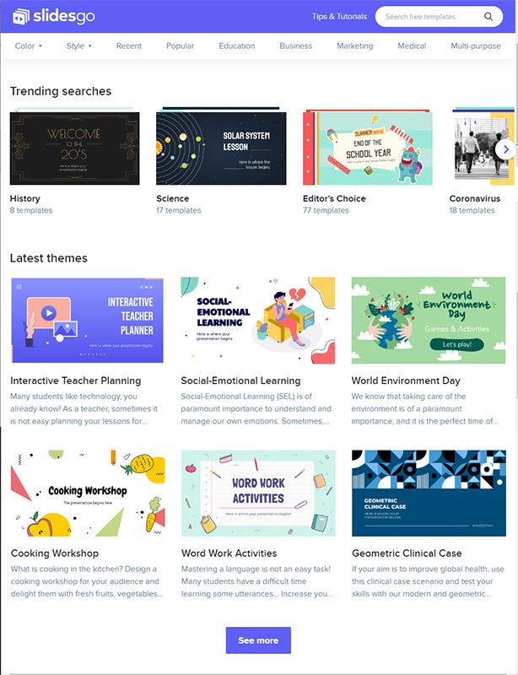
Tablet App
You can replace the image on the screen with your own work. Just delete this one, add yours and center it properly

Slide 24
05
Events

Slide 25
Review of Past Events
Jupiter
Neptune
06/20/2020
03/05/2020
It’s the biggest object in the Solar System and also a gas giant
Neptune is the fourth-largest planet in the Solar System

Slide 26
Upcoming Events
May 02
June 10
July 20
Mercury is the closest planet to the Sun and the smallest one
It’s the biggest object in the Solar System and also a gas giant
It has a beautiful name and is the second planet from the Sun

Slide 27
Thanks
Do you have any questions?
addyouremail@freepik.com
+91 620 421 838
yourcompany.com
Please keep this slide for attribution

Slide 28
Alternative Resources

Slide 29
Resources
Photos
Vectors
Hands
Ethnic woman
Boy smiling
Business
Different people
Multiracial
Happy-people

